Slide 1
High School Student Test Results
Notes:
In this storyboard, I am going to present a dataset that contains information about high school students’ test results in reading, writing and mathematics, as well as demographical information such as parents’ highest education level, race, and sex. The aim of this investigation is to locate patterns in attributes that may impact a student’s academic performance.

Slide 2
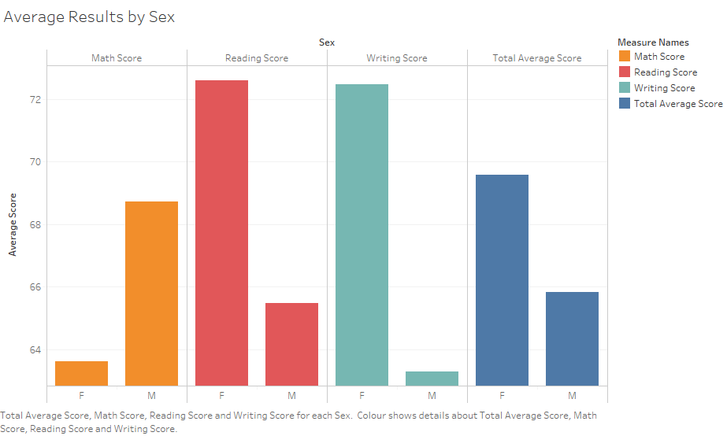
Notes:
This chart shows the average score in each area, as well as the overall average score, by sex. It can clearly be seen that on average, males achieve higher scores in Math, whereas females achieve higher scores in Reading and Writing, as well as overall. It will be interesting to explore how sex may interact with some of the other demographical attributes available in the data.

Slide 3
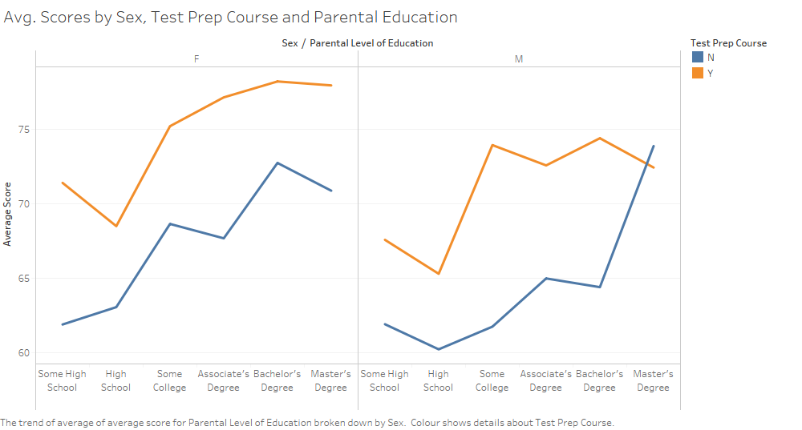
Notes:
This chart dives further into the data, showing the average test scores by the students’ highest parental level of education, whether they had completed a test preparation course prior to taking their tests, and sex. Again, it can be seen that female scores are on average higher than the male scores, as well as that those who had completed the test preparation course mostly performed better than those who had not. There is one exception to this, in the group of males who had a parent who had completed a Master’s degree; here, those who had not completed the test preparation course performed better than those who had, on average.
In general, the trend is that the higher the level of parental education, the higher the test scores. This could suggest that parents with higher education may be assisting their children with their homework or study. It could indicate some sort of genetic predisposition towards performing well academically. It could even reference the fact that in general, those with higher education come from more well-off socioeconomic backgrounds, meaning that both the parents and the child have more energy to spend time on schoolwork and studying. Most likely, this trend indicates a number of these insights, but further statistical and social analysis would be necessary to confirm this.

Slide 4
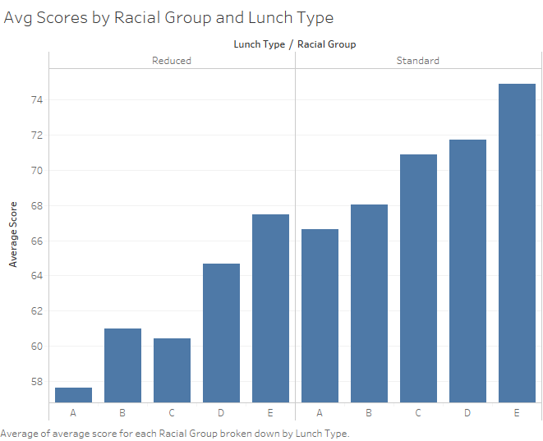
Notes:
In this final chart, we see students’ average scores by racial group (split into A, B, C, D and E), and lunch type (Reduced or Standard). This chart shows an increasing trend in the scores based on racial group, with group A being the lowest, followed by groups B and C, then group D, and with group E having the highest average score. It is worth noting that in the Reduced lunch type chart, the average score for racial group B is slightly higher than that of racial group C; however, this difference is close enough that it would take further statistical analysis to know if this is a significant difference, or if it is just noise.
It can also be seen that there is a significant difference in the average scores between the Reduced lunch and the Standard lunch group. It can be inferred that this is most likely due to the socioeconomic background of students, as it would be students with less resources that would be eligible for the reduced lunch scheme. This difference appears to be quite significant, with only racial group E in the Reduced lunch group performing slightly better than any of the racial groups in the Standard lunch group.
The exploratory data analysis in this presentation indicates that there are factors that have a significant impact on students’ academic performance. Several of the attributes investigated appear to be related to the socioeconomic status of a student’s family. As such, it may be worth performing further statistical and social analysis over these factors, in order to consider how best to support students that are disadvantaged at school due to their family situation.

